Slide 1
ONLINE/CYBERBULLYING
Bullying is far more wide-spread now it is online - it’s not just your time in school. It affects your social life.
A SCHOOL PERSPECTIVE

Slide 2




ONLINE BULLING COMES IN MANY FORMS THAT WE SEE IN SCHOOL:
Online bullying doesn’t create large numbers of new victims
Most bullying is face-to-face – with online bullying used as a modern tool to supplement traditional forms
Using WhatsApp class/peer groups to victimize children – either by exclusion or hurtful comments (direct and indirect) – trolling
Being added to unfamiliar groups – no control over who joins the group
Posting derogatory comments about teachers
Using Snapchat to spread rumours and share pictures without consent – trolling/tagging
Posting derogatory comments about teachers
Being called names, sworn at or insulted and having nasty messages about them sent to them were the two most common online bullying behaviour types
Using Tik Tok to post unkind messages about uploaded content - trolling
Destroying realms in Minecraft/Leaving unkind messages during gaming/intimidation/ being kicked out or left out of gaming parties - trolling

Slide 3
How this impacts on children:
Not wanting to come to school
Lack of confidence/self esteem
Anxiety/stress induced behaviours – self harming
Social exclusion at school
Fear of parental involvement (devices taken away)

Slide 4


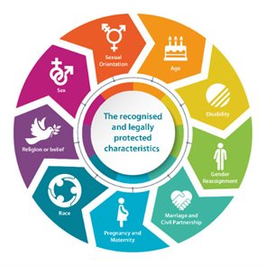
Most at risk:
girls were twice as likely as boys to report being bullied online
Girls – self-image is very important as is navigating the choppy waters of friendships. Finding where they fit in the social strata of life. Girls seems to know how to hit where it hurts most emotionally.
Protected characteristics – anyone who might be deemed ‘different’. How they look, their religion, neurodiversity, disability etc.
Children that are shy or socially awkward.

Slide 5
How we tackle online bullying:
PSHE Curriculum
• Keeping safe online and who to go to for help • Rights and responsibilities online • Reducing screen time • Online pressures and influences that can impact on a person’s wellbeing e.g. comparison of body image, • Social networking – the pros and cons
How to stay safe online – at the beginning of computing lessons. Whole school, approach – policies/ golden rules
Zero tolerance – not banter!
Recorded on CPOMS – build a bigger digital picture
In class workshops/assemblies – NSPCC – SOSS!
Parent workshops/school website – tutorials - sign posting to support networks
Newsletters
Online agreement – responsible user policy
Staff training – NSPCC/Anti-bullying Alliance

Slide 6
A whole School Approach:
A whole-school approach is the first step toward preventing all forms of bullying, including cyberbullying. Parents will be involved in all incidents of online bullying.
Children and young people should be taught how to use technology safely and responsibly. Explaining what kinds of behaviours are appropriate, and encouraging students to think about other’s thoughts and feelings can stop them from engaging in cyberbullying.
The school’s response to cyberbullying should be clearly outlined, so that all members of the school community are aware of what will happen when incidents of cyberbullying are reported. Cyberbullying should be specifically referred to within the school’s antibullying policy – screenshot, report, block
• Students should be aware of what cyberbullying is and the dangers that using technology poses. Integrating online safety and cyberbullying into the school curriculum.

Slide 7
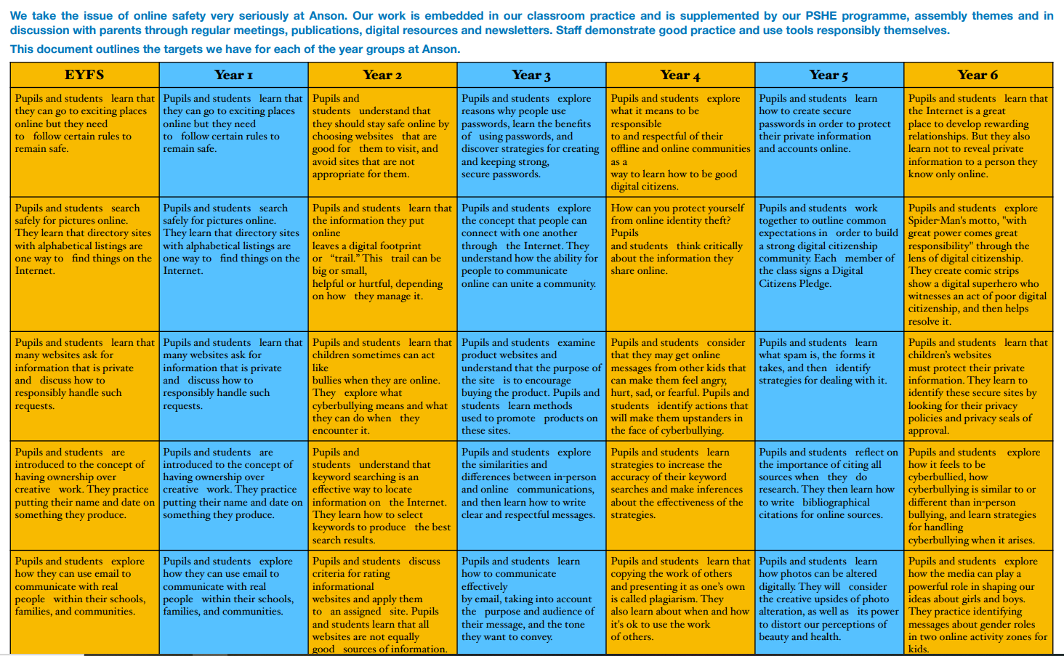

Slide 8




A whole School Approach:
The positive aspects of technology should be promoted, and lessons should cover how to use technology safely and responsibly.
Work with those who are responsible for the bullying behaviour. Advising them on how to use technology safely and responsibly, as well as encouraging them to think about how their actions affect others, may help to dissuade them from engaging in further bullying.
To encourage children and young people to report incidents of cyberbullying, reporting procedures should be clearly outlined. Those who experience cyberbullying should know exactly how and to whom it should be reported.
Depending on the nature of the incident, offer advice as to what their next steps should be. This could range from saving evidence, through to showing the student how to block someone, or change their privacy settings. The most important advice is to prevent the child from retaliating, as this will likely enflame the situation.

Slide 9
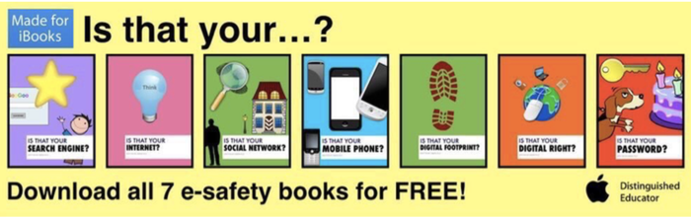
Mr Pile has written 7 books to help keep everyone safe and secure online. So far over 20,000 copies of these FREE books have been downloaded across the world.
Dealing with issues in the real world and online
Children may face issues in their lives in the real world and online. The Anson Digital Leaders wanted to help other children deal with these issues. So, this video was created by them to support children who may be experiencing bullying in the real world or online. It was shortlisted for Animation of the Year at the Into Film Awards 2018.
Our Digital Leaders have all been accredited by Childnet on the Childnet Digital Leaders Programme.
.
https://youtu.be/bSvPpAqouoE

