Slide 1
SECONDARY TRANSFER 2027
CLOSING DATE
31 OCTOBER 2026

Slide 2
Before you make your application
Do your research – read the secondary booklet, school open events (check the schools website for booking information), ofsted reports, location of schools – what would the journey be like?
https://www.brent.gov.uk/education-schools-and-learning/school-admissions/apply-for-a-secondary-school-place#planandprepare
Read the admissions criteria for each school, the admission criteria is what the offers are based on
Visit as many of the schools as you can
Distance measurements – they change every year!!
Make realistic preferences

Slide 3
Apply Online & On time!
Apply online and click submit at the end of the application before 31 October 2026
https://www.eadmissions.org.uk/
Make a note of your username, password and application reference number
Booklet gives a step by step guide to the online system
If new to eAdmissions – register in advance
You will need your Council tax account number - address
If your application is late, it will be looked at after all those that were submitted on time – unlikely to get a preferred school!

Slide 4
Completing your application
List your preferences – in the order you would like them considered
Read the application form carefully – do not tick the boxes that are not relevant to your child
Additional/supporting information must be given, otherwise your request will not be considered under that criteria
Do not list the same school more than once – duplicates will be deleted
Supplementary Information forms (SIF) – must be returned to the school by 31 October 2026
You still need to apply even if you have another child at that school – make sure you include the details of siblings in the application – you may miss out on this criteria!

Slide 5

SEND/ EHCP –different application process
Looked After & Previously Looked After Children – may have to be of that faith/meet that religious practice test
Social/Medical
Siblings
Children of staff
Distance
Tie-breaker situations – distance or random draw

Slide 6
Selective Schools
You are strongly advised to check the individual schools website for any updated information
You must still add the selective school to your list of preferences on your application or you will not be considered for a place at the school

Slide 7
Address Verification
Address of convenience - protocol
Siblings of fraudulent applications – if a place is obtained for an older child using fraudulent information, there will be no sibling connection to subsequent children from that family.
Proofs of address & change of address (deadline date 12 December 2026)

Slide 8
How your application is processed
Applications and addresses are checked and details sent to schools
Schools do not know the order of your preferences!
Schools rank the applications according to their selection criteria
Brent schools decide whether your child qualifies for a place – not the council
The council will then select the highest preference that has qualified for an offer.
If you do not qualify for a place at any of your preferred schools – a place is offered at the nearest school with an available space

Slide 9
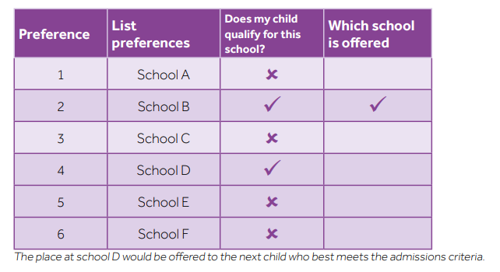

Slide 10
Date | Deadline
31 October 2026 | Deadline for applications to be received
1 March 2027 | Offer day
Mid-March 2027 | Deadline for acceptances
Mid-March 2027 | Deadline for applications for the second round
End of March 2027 | Second round offers
Beginning of April 2027 | Deadline for second round acceptances
Beginning of May 2027 | Deadline for applications for the third round
End of May 2027 | Third round offers
End of May 2027 | Deadline for third round acceptances

Slide 11
Top Tips
READ THE SECONDARY BOOKLET
READ THE ADMISSION ARRANGEMENTS FOR SCHOOLS
READ THE APPLICATION FORM CAREFULLY
LIST MORE THAN 1 PREFERENCE TO MAXIMISE YOUR CHANCE OF SECURING A SCHOOL PLACE FOR YOUR CHILD
MAKE REALISTIC PREFERENCES
CHECK THE SCHOOL WEBSITE FOR ANY OPEN EVENT INFORMATION & BOOKING
APPLY ON TIME – 31 OCTOBER 2026 DEADLINE DATE

